Slide 1
Learn Why use Selenium with 3 Million Dollar Bugs ?

Slide 2
Agenda
What Is A Million Dollar Bug?
Million Dollar Bug #1
Million Dollar Bug #2
Million Dollar Bug #3
Impact Of A Million Dollar Bug
Best Practices to Avoid Such Bugs
How Selenium Automation Helps

Slide 3
What Is A Million Dollar Bug??

Slide 4
What Is A Million Dollar Bug??
A bug that took a million dollar to get detected
A bug that costed a million dollar damage in business
A bug that has caused a damage to company’s reputation
A bug which has been reported by a customer

Slide 5
Million Dollar Bug #1

Slide 6

Bug #1 : Immigration
The system was incapable of dealing with backlog cases.
Resulted in 29000 applications backlog.
Also failed to locate 50000 people
Cost up to $1.6 billion

Slide 7
Million Dollar Bug #2

Slide 8
Bug #2 : Automobile
Software glitch that can potentially shutdown the hybrid system while on the road
Worldwide recall for 1.9 million hybrid prius cars
130,000 hybrid prius cars in europe
713,000 in north America
997,000 in japan
Toyota has recalled over 1.9 million hybrid Prius cars due to a software glitch
Cost more than $2 billion

Slide 9
Million Dollar Bug #2

Slide 10
Bug #3 : E-Commerce
Products on sale for just One penny in Amazon marketplace.
Many picked up items as expensive as mobile phones for just 1 penny.
This glitch was attributed to a bug in amazon price comparison software
Cost up to $100,000

Slide 11
How Do These Bugs Creep In
Human factor
Communication failure
Unrealistic development timeframe
Poor design logic
Poor coding practices
Lack of version control
Buggy third-party tools
Lack of skilled testing
Last minute changes

Slide 12
Impacts
Huge monetary loss
Damage to brand reputation
Employee Dissatisfaction/churn
Shutdown of a particular service/company
Customer Dissatisfaction/churn
Legal issues

Slide 13
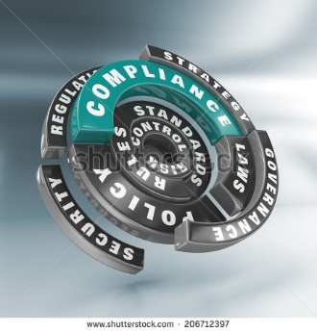
Best Practices to Avoid Bugs
Avoid fancy coding, Follow standards

Slide 14

Best Practices to Avoid Bugs
Avoid fancy coding, Follow standards
Use available libraries

Slide 15
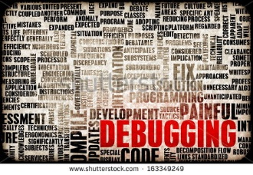
Best Practices to Avoid Bugs
Avoid fancy coding, Follow standards
Use available libraries
For existing code, learn how to refactor

Slide 16

Best Practices to Avoid Bugs
Avoid fancy coding, Follow standards
Use available libraries
For existing code, learn how to refactor
Don't do anything too quickly

Slide 17

Best Practices to Avoid Bugs
Avoid fancy coding, Follow standards
Use available libraries
For existing code, learn how to refactor
Don't do anything too quickly.
Follow Test driven development approach

Slide 18

Best Practices to Avoid Bugs
Avoid fancy coding, Follow standards
Use available libraries
For existing code, learn how to refactor
Don't do anything too quickly.
Write unit tests and integration tests
Follow Test driven development approach
Testing

Slide 19
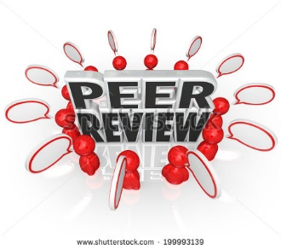
Best Practices to Avoid Bugs
Avoid fancy coding, Follow standards
Use available libraries
For existing code, learn how to refactor
Don't do anything too quickly.
Follow Test driven development approach
Get somebody else to look at the code
Write unit tests and integration tests
Testing

Slide 20

Best Practices to Avoid Bugs
Avoid fancy coding, Follow standards
Use available libraries
For existing code, learn how to refactor
Don't do anything too quickly.
Get somebody else to look at the code
Test your code, then have it tested by someone else
Write unit tests and integration tests
Involve your testers as early as you can
Try to automate test cases for any complex platform
Testing

Slide 21
Why Rigorous Testing is Mandatory
To point out the defects and errors that may cause million dollar loss to a system
To ensure that what we create does what it’s supposed to do
To ensure the delivery of best product and experience
To ensure that the something works on every intended machine
To have effective performance of software application or product.
To stay in the business

Slide 22
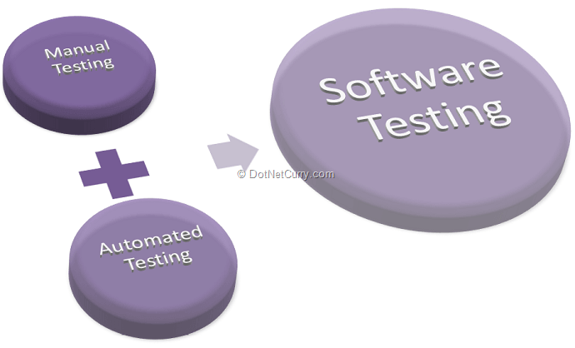
Ways of Software Testing

Slide 23
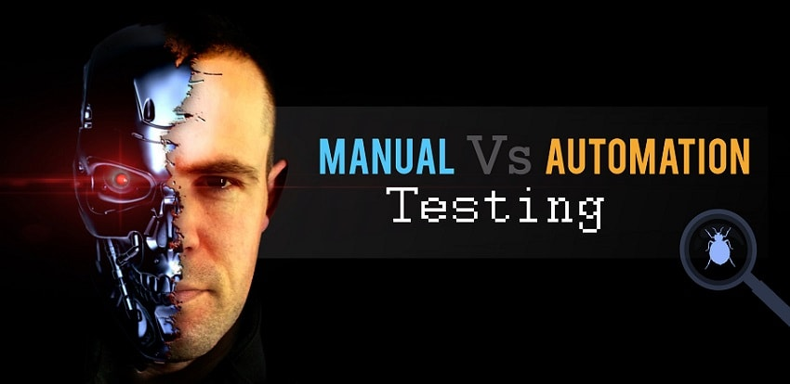
Manual Vs Automation

Slide 24
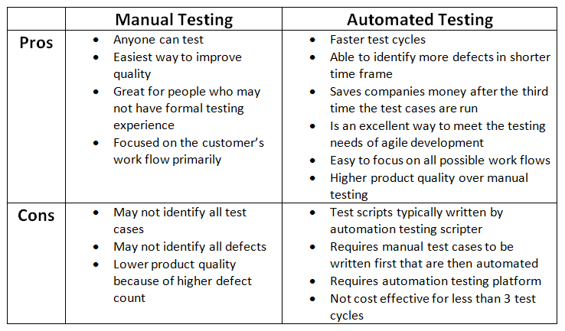
Manual Vs Automation

Slide 25
Which Test Cases To Automate And Which To Not?
Test cases to be automated can be selected using the following criterion :
High Risk - Business Critical test cases
Test cases that are executed repeatedly
Test Cases that are very tedious or difficult to perform manually
Test Cases which are time consuming
The following category of test cases are not suitable for automation :
Test Cases that are newly designed and not executed manually at least once
Test Cases for which the requirements are changing frequently
Test cases which are executed on ad-hoc basis.

Slide 26
Selenium salient features
Open source – no extra cost to find bug
Light weight (<100 MB)
Multiple languages support( java, C#, python, ruby etc…)
All browser support (chrome,mozilla,ie,safari etc…)
OS support (linux,windows,ios etc…)
Easy bug reporting
Wide ecosystem support
Develop script once, run the same on multiple browser
Special handling of ajax control
Parallel script execution

Slide 27
Selenium WebDriver salient features
Real events in the browser
Webdriver object triggers real events in the browser: mouse clicks, button clicks, entering text, and events from the keyboard
Drives a specific set of commands and check status
Drives a specific set of commands and check status—to see if the user is logged in, if the book goes into the shopping cart, or if a transaction processes.
Report with the number of assertions
Webdriver will kick out a report with the number of assertions, the ones passing and failing, and where the errors occur
Automate your actions in a web browser
Automate your actions in a web browser and save them as automated tests that you can replay at a later time.

Slide 28
Can We Avoid Bugs Completely??
Can we Eliminate every chances Million Dollar Bugs by following best practices ??
No one's perfect, and no matter what we do, we are going to produce code that has bugs in it from time to time

Slide 31
Survey

